Slide 1
Moon Direct: A Coherent and Cost-Effective Plan to Enable Lunar Exploration and Development
Robert Zubrin
Pioneer Astronautics
11111 W. 8th Ave. unit A
Lakewood, CO 80215

Slide 2
Defining the Requirements for an Effective Lunar Program
The most important step in any engineering program is to define its requirements.
While it is essential to design things right, before that can even be attempted we must make sure that we are designing the right thing.
The logic of Moon Direct beings by defining the requirements for a highly cost-effective lunar exploration program.
These are:
1. Maximum access to the lunar surface
2. Minimum development and recurring cost
3. Minimum schedule.
4. Minimum risk.

Slide 3
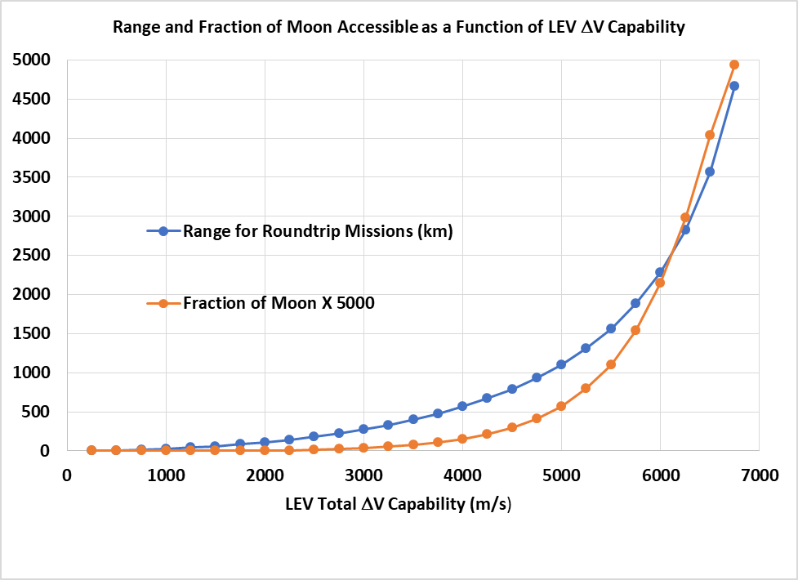
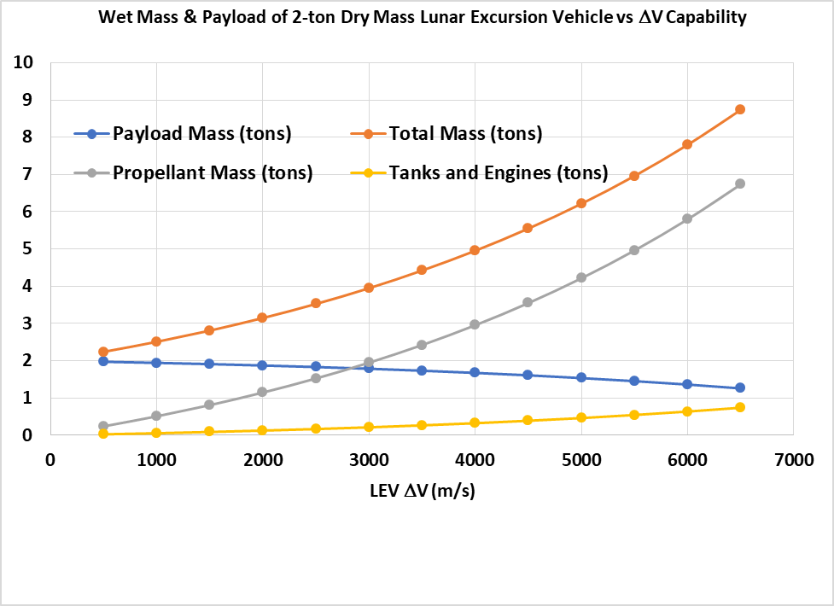
Mobility of the Moon
The number one requirement for effective exploration of the Moon is mobility.
The Moon is a world with a surface area equal to the continent of Africa. Its terrain is rough, roadless, and riverless.
Lunar explorers are going to need to fly!

Slide 4
The Moon Direct Plan
We see that a Moon base producing LOx/H2 propellant to support a LEV would enable global access, direct return, and very low recurring costs. These are the prime requirements for a highly cost-effective lunar exploration program.
There are three phases required for such a program.
Phase 1: Automated missions deliver a hab module and other cargo one way to the lunar surface to preposition the base in advance of the crew.
Phase 2: Initial piloted missions to make the base operational. These missions must be flown without the benefit of in-situ propellant production (ISPP). A key objective of this phase is to make ISPP operational.
Phase 3: The recurring piloted mission, which can be done making use of ISPP.

Slide 5
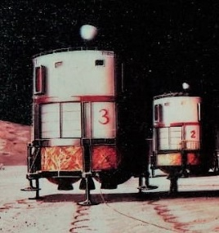
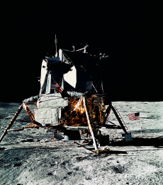
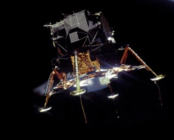
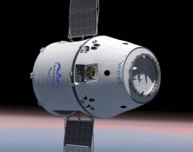
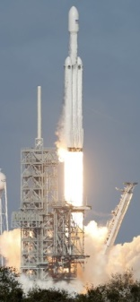
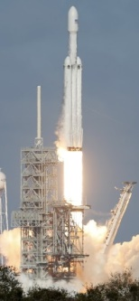
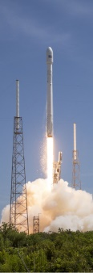
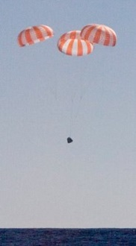
Moon
Phase 1
Base Emplacement
Phase 2
Initial Crew Landing
Phase 3
Recurring Mission
Earth Orbit
Earth

Slide 6
Phase 1: Delivery of Hab and Cargo to the Moon
Aside from the LEV itself, we have need for only one kind of cargo lander, which we will use to deliver the base hab modules and other cargo in Phase 1, as well as the fueled LEV that needs to be delivered in Phase 2 to the Moon until local propellant production is operational.
In Table 1, we show the cargo that could be delivered to the Moon with a single launch of a variety of launch vehicles, using only a single stage system that takes the cargo from a staging orbit to the lunar surface.
In the analysis presented, we used DVs of 6.1 km/s for LEO to the lunar surface (LS), 3.7 km/s for geosynchronous transfer orbit (GTO) to LS, and 3 km/s for trans lunar injection (TLI) to LS. For the cargo lander propulsion system, we consider both LOx/CH4 with a 375 s Isp, 0.07 stage dry fraction, 800 kg/m³ density, and a LOx/H2 with 450 s Isp, 0.11 stage dry fraction, 300 kg/m³ density.
Flight systems considered include: Falcon Heavy with 62 tons to LEO, or 26 tons to GTO, 5 m fairing; SLS with 90 tons to LEO, 8 m fairing; New Glenn with 45 tons to LEO, 7 m fairing; Vulcan with 30 tons to LEO, 5 m fairing; and BFR 150 tons to LEO, or if refueled 150 tons to TLI, 8 m fairing.

Slide 7
Phase 1: Cargo Delivery Capabilities
Launcher Staging Orbit Propulsion Tank Length Payload Delivered
Falcon H LEO LOx/CH4 3.2 m 8.3 tons
Falcon H GTO LOx/CH4 1.05 8.3
Falcon H LEO LOx/H2 7.9 10.4
Falcon H GTO LOx/H2 2.5 9.6
New Glenn LEO LOx/CH4 1.12 6.0
New Glenn LEO ` LOx/H2 2.85 7.5
Vulcan LEO LOx/CH4 1.54 4.0
Vulcan LEO LOx/H2 3.8 5.0
SLS LEO LOx/CH4 1.9 12.0
SLS LEO LOx/H2 4.45 15.0
BFR LEO LOx/CH4 3.2 19.9
BFR TLI LOX/CH4 2.5 60.0

Slide 8
Phase 2
The base now being operational it is time to send the first crew.
A Falcon Heavy is used to deliver another cargo lander to orbit, whose payload consists of a fully-fueled LEV. This craft consists of a 2-ton lightweight spacecraft like that used by the Apollo era Lunar Excursion Module together with a 6-tons of hydrogen/oxygen propellant, capable of delivering it from the lunar surface to Earth orbit. A man-rated Falcon 9 rocket then lifts the crew in a Dragon capsule to LEO where they transfer to the LEV. Then the cargo lander takes the LEV, with the crew aboard, to the Moon, while the Dragon remains behind in LEO.
After landing at the Moon base, the crew completes any necessary set up operations and begins exploration. A key goal will be to travel to a permanently-shadowed crater and making use of power beamed to them from the base, use telerobots to mine water ice.
Having spent a couple of months initiating such operations and engaging in additional forms of resource prospecting and scientific exploration, the astronauts will enter the LEV, take off and return to Earth orbit. There they will be met by a Dragon – either the one that took them to orbit in the first place or another that has just been launched to lift the crew following them - which will serve as their reentry capsule for the final leg of the journey back home.

Slide 9
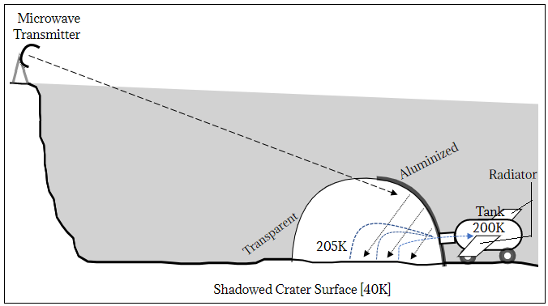
Mining Water Ice on the Moon

Slide 10
Phase 3
Until lunar propellant production is operational, each mission that follows will require just one $120 million Falcon Heavy and one $60 million Falcon 9 to accomplish.
As soon as propellant production is operational, however, crews will be able to fly back to the Moon in a LEV refueled with 6 tons of propellant in LEO, allowing recurring missions to be done with just a single Falcon 9 launch each.
Once the base is well-established, there will be little reason not to extend surface stays to 4 months or more. So, assuming that the program hardware purchases will roughly equal its launch costs, we should be able to sustain a permanently occupied lunar base at an ongoing yearly cost of less than $400 million. This is less than 2 percent of NASA’s current budget.
As noted, the astronauts will not be limited to exploring the local region around the base. Refueled with hydrogen and oxygen, the same LEV spacecraft used to travel to the Moon and back can be used to fly from the base to nearly anywhere else on the Moon, land, provide onsite housing for an exploration sortie crew, and then return them to the base.
We won’t just be getting a local outpost: we’ll be getting complete global access to an entire world.

Slide 11
Alternative Options
We consider five alternative mission modes. These are:
A. Program of Record: First construct a Lunar Orbit Gateway (LOG), and then use it as a node to send the Orion spacecraft to low lunar orbit (LLO), and then conduct the mission to the surface via LOR, with a LEV type vehicle going from LLO to the lunar surface (LS) and back. Orion then returns the crew to aeroentry at Earth
B. LOR-Orion: Same as option B, except no LOG is constructed.
C. LOR-Dragon: Same as option C, except a Dragon is used instead of Orion.
Direct Return: Dragon delivered to surface. Dragon flies directly back to TEI, aeroentry
EOR (Moon Direct): Crew to orbit in Dragon. Goes to Moon in LEV.
Direct return to rendezvous with capsule in Earth orbit.

Slide 12
Comparison of Options
Option A. LOG B. LOR-Orion C.LOR-Dragon D. Direct Return E. Moon Direct
Ph 1 IMLEO 240 120 120 120 120
Ph 2 IMLEO 126 126 56 120 68
Ph 3 IMLEO 110 110 40 53 14
Total IMLEO 2692 2572 1032 1300 536
Surface % Access 3 3 3 42 42

Slide 13
Conclusion
It can be seen that the Moon Direct approach is decisively the best. Its advantages include:
1. Lowest total program launch mass. (~1/2 that of closest alternative)
By far the lowest recurring mission launch mass. (~1/3 that of closest alternative)
By far the greatest exploration capability (14 times surface access as 4 km/s LOR-class LEV)
4. No need for lunar orbit rendezvous.
There is no point going to other worlds unless we can do something useful when we get there.
Turning local materials into resources is the key.
The resourceful will inherit the stars.

