Slide 1
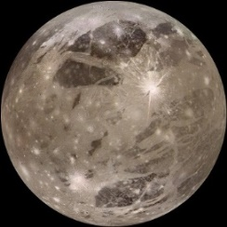
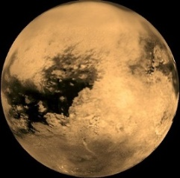
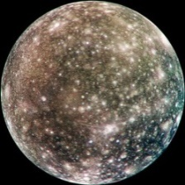
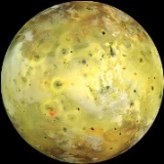
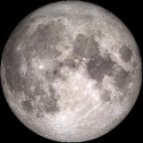
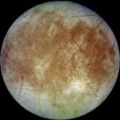
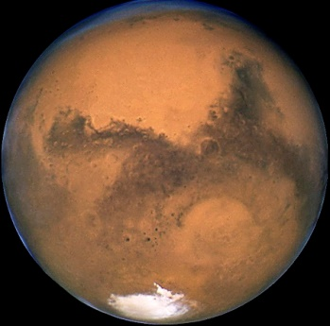
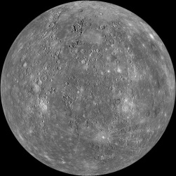

Living Beyond Earth, in Partial Gravity
Mars Society Conference
September 2017, UC Irvine
6 moons, at 12-18% of earth gravity
2 planets, each 38% of earth gravity
Joe Carroll
Tether Applications, Inc.
619-980-1248 mobile
tether@cox.net

Slide 2
A Remarkably Convenient Coincidence
1. All planets but Jupiter have gravity very near Earth or Mars.
2. The 6 large moons in our solar system all have similar gravity.
3. So 3 gravity levels matter most: Earth, Mars, and our Moon.
4. Bodies with partial gravity are more accessible & practical!
5. Life evolved in 1 gee. How will it do at Mars & Moon levels?
2.72
~Earth
~Mars
1/e steps
~Moon
Gravity Levels on the Planets, Largest Moons, & Asteroids

Slide 3
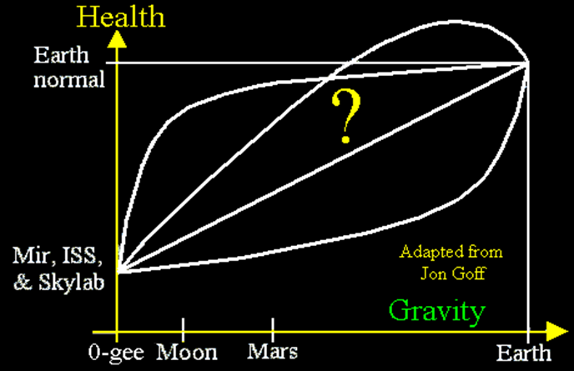
Why Is Partial Gravity Important for Humans?
1. We know 1 gee is ok but micro-gee causes many problems.
Bodies with partial gravity are more accessible & practical!
Partial gravity may also be good for free-space colonies.
4. Apollo showed no clear effect of 1/6 vs μ-gee in 1-3 days.
5. We don’t know whether or how we can settle in <1 gee!

Slide 4
Questions for Early Partial Gravity Bio Research
Questions critical to planning realistic settlements:
1. Can people stay healthy for years—and years later?
2. Do rodents & primates reproduce normally in low gravity?
3. Can primates raised in low gravity adapt to earth gravity?
4. What crops and ecosystems may be best to use off earth?
Nearer-term manned exploration issues:
5. How much gravity should we use cruising to/from Mars?
6. How much gravity should we use on-station near NEOs?
7. What spin rates and hab designs are best for cruise?
8. What countermeasures are needed on the Moon or Mars?
Other:
9. What can we learn from ISS’s small-sample centrifuges?
10. What conventional wisdom is wrong about key crops?

Slide 5
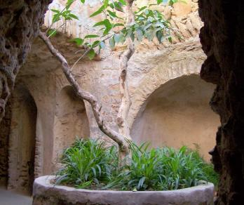
Where Should We Start Partial-Gravity Studies?
A spinning facility in LEO? (co-orbiting with the ISS?)
- Lowest facility launch & support costs; hours travel each way
- Easiest and quickest sample return & experiment iteration
- Lowest cosmic + trapped radiation doses (but still an issue!)
- If useful, could support crew adaptation on way to/from ISS
A spinning facility at L1, or elsewhere in deep space?
- Travel time days to weeks, not many months as with Mars
- Highest cosmic ray + solar-flare radiation doses; hard to shield!
Moon or Mars base? (buried, for shielding)
- Radiation limits surface time (live in lava tube)
- Travel times: days to moon; >6 months to Mars
- Easy access to local “soil”; sample return hard
www.undergroundgardens.com

Slide 6

Concept for a Partial Gravity Research Facility
A rotating facility in low earth orbit can provide any desired partial gravity levels, at far lower cost & risk than setting up & running facilities on the Moon & Mars.
In particular, assymmetrical dumbbells with ~7:3 mass ratio can provide both Moon and Mars gravity levels.
Such a facility can study the response of both humans and other bio systems (including crops) to the 2 partial gravity levels relevant to 8 bodies in our solar system!
The major unknown is the allowable rotation rate, which drives the required length of the facility. Tether tests in crewed Dragon 2 vehicles may be able to determine this.
Mars
CM
Moon

Slide 7
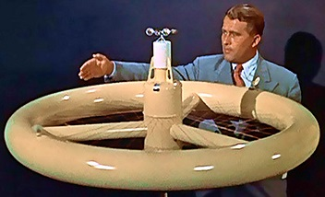
Advantages of Dumbbell over Donut
A dumbbell layout allows a far
larger radius and far lower Coriolis
effects, with far lower total facility mass.
An asymmetrical dumbbell can inherently provide the two most useful partial-gravity levels; one donut cannot.
One dumbbell “cabin” plus a used stage counterweight allow useful early tests and design refinements, while a donut isn’t usable until launch + assembly are complete.
Trapezes hanging outward can capture visiting vehicles from lower orbits, and target deorbit of passive payloads.
A donut of usable size will cost so much that you will probably have to fly a dumbbell first, to sell the donut.
Mars
CM
Moon

Slide 8
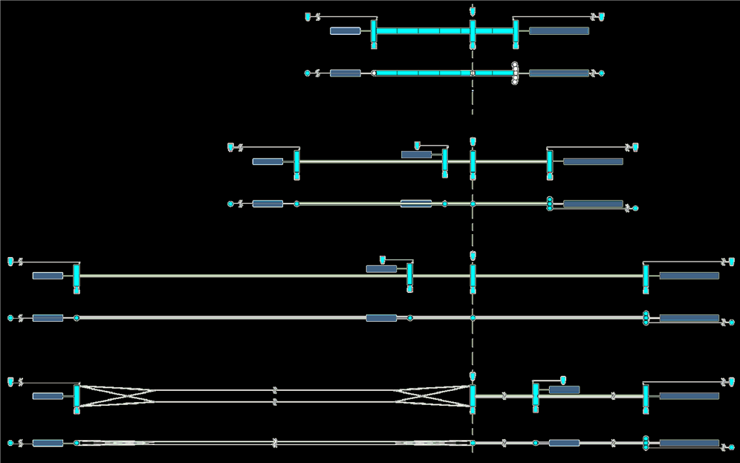
Spin Rate Drives Dumbbell Length and Design
Mars cabins
2 rpm, 121m,
rigid modules:
Lunar cabins
Spin
axis
1.5 rpm, 216m,
pressurized tunnels:
IP view
OOP view
1 rpm, 486m, pressurized tunnels:
0.55 rpm, 1600m: tunnels + cables
A = ω²r, so for half the spin rate, you need a 4X longer facility!

Slide 9
The Key Unknown: Spin Rate (& Tunnel Length!)
Mars
node
(0.06g
node)
CM
Moon
node
We really don’t know what rotation rates are reasonable, since ground-based rotating rooms have very different effects. We need tests of rotation & Coriolis sensitivity relevant to spinning artificial-gravity facilities. Cutting the spin rate by half requires a 4X greater length, so we should consider designs for a wide range of lengths:
Some Options for Radial Structure
Spin rate Length Radial structure Key length-limiters
>2.0 rpm <120m Rigid modules Mass of radial modules
> 0.70 rpm <1000m Airbeam tunnels Tunnel area, impact risk
> 0.55 rpm <1600m Tunnels + cables Area; post-cut perigees
> 0.25 rpm < 8000m Cables Cable mass; ” ”

Slide 10
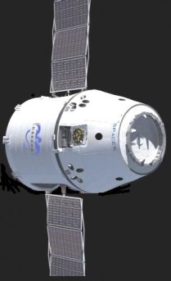
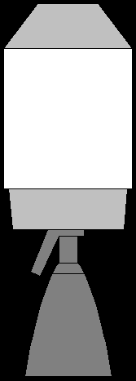
Gemini-like Dragon Spin Sensitivity Tests
Scenario (during phasing, on crew flights to ISS)
1. Fly away from stage to pull out “stitched-down” tether.
2. Dragon spins up using posigrade pulses all around orbit.
3. Pause spin-up several times to test adaptation to the spin.
4. Proper phasing of parking orbit eccentricity and tether release may allow free targeted deorbit of Falcon stage.
5. Refine & repeat on multiple missions, to get more data.
Can low gravity ease crew accommodation to free fall?
This resembles the test on Gemini 11, except that:
1. It uses a longer (500 vs 30m) & stronger “seatbelt” tether.
2. It spins faster: 1 rpm gives lunar gravity, 148 m from CM.
3. No counterweight capture is needed (use Falcon stage).
4. A lossy 3-point bridle can stabilize the Dragon attitude.
5. Bridle must stow in grooves in TPS, as chute rigging does.
CM

Slide 11
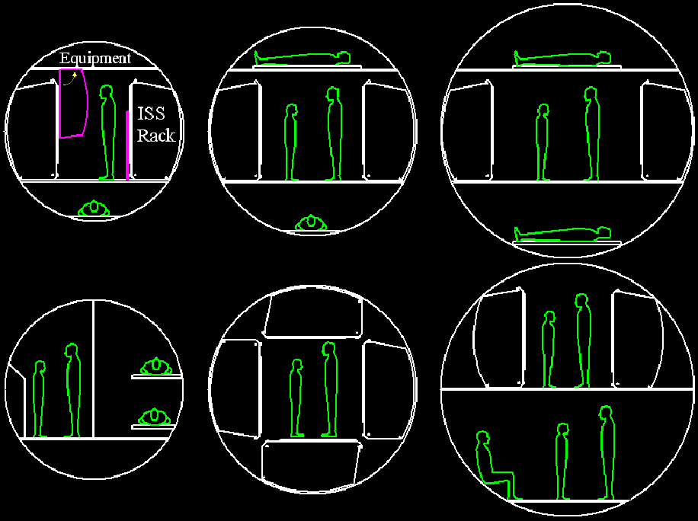
What Module Diameter & Layout(s) Should We Use?
5.2 meter dia
3.6 meter dia
4.2 meter dia
ISS lab layout

Slide 12

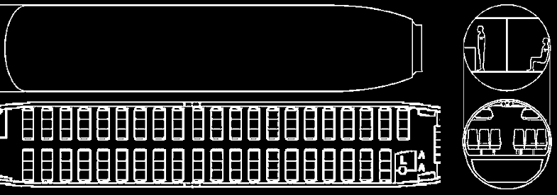
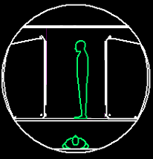
Key Dumbbell Part #1: ~737-Size Hab Modules
Standard
F9 fairing
~ Equal peak aero bending
loads
(F9 Block 1 shown; 1.1 is longer)
- 3.6 x ~17m cabin (build on Falcon 9 line?)
- Launch on Falcon Heavy; add more after assy
- Deploy standoff MMOD shield once in orbit
3.5 x 18m 737-600 cabin

Slide 13
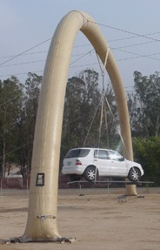
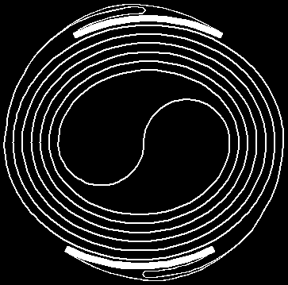
Key Dumbbell Part #2: Inflatable Radial Tunnels
Transhab-like inflatable tube
- Vectran fiber in flexible matrix
- Damage tolerant; easy to customize
- Allows shirtsleeve end-to-end travel
- Use translucent tunnels & grow food
Stows very compactly for launch
- Fold deflated beam in half & roll up
- Keeps rigid end fixtures on outside:

Slide 14
Growing Food in Inflatable Radial Tunnels
Why use tunnels to grow food?
1. Large sun-lit areas are feasible at low added mass.
2. Airflow & “rain” can aid cabin thermal control.
3. Geometry should ease farming automation.
How must overall facility design be modified?
1. Use quartz fiber in silicone to pass filtered sunlight.
2. Use 2 parallel tunnels to allow large air flow loops.
3. Add tanks to raise fish that eat crop waste mass.
What key issues need early study?
1. Do we need LEDs during each <36 minute night?
2. How much thermal mass do we need for the night?
3. How much will adequate MMOD protection weigh?
4. Can farm automation experts make this work?
Many land-grant colleges already develop spacecraft, but their agriculture departments don’t—yet!
Moon
CM
0.06g
Mars

Slide 15
Conclusions
1. Man has been going into orbit for >50 years, but we seem stuck. Maybe we should learn more about our physiology before we even plan multi-year missions.
2. Three gravity levels (Earth, Mars, Moon) cover all 13 large bodies of interest in our solar system. And the 8 partial-gravity bodies are more accessible and usable! Partial gravity research clarifies our future off earth.
We can start with tumbling dumbbell tests like the Gemini 11 test, to learn what spin rates are best.
Settlements will need local food production, recycling, & overall sustainability even more than better rockets.
Sustainability on and off earth have more in common than power or transport technologies do—so use this!

Slide 16
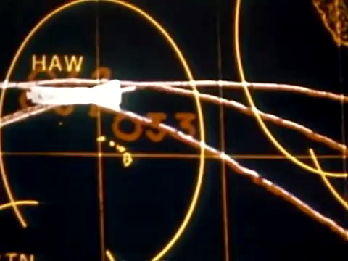
Slow Spin Test of Gemini 11 + Agena (90 sec)

Slide 17

Backup Slides

Slide 18
Don’t Rotating-Room Tests Show What Spin Is OK?
1. Effects of rotation on the inner ear are different
- In rotating rooms, the felt rotation axis and rate stay the same as you move & turn around, unless you tilt your head.
- In orbit, axis and/or rate change each time you turn around.
- Ground tests show you can adapt to spin reversal, but it takes time. In orbit, sudden felt reversal will happen often!
2. Felt Coriolis accelerations are very different
- In rotating rooms on the ground, walking in any direction causes the same felt side-force, and weight does not vary.
- In orbit, you get heavier if you walk with the spin, and lighter against it. This may cause stumbling, as when you walk in an elevator as it accelerates (typ. ~ 0.05 gee).
Mars
CM
Moon

Slide 19
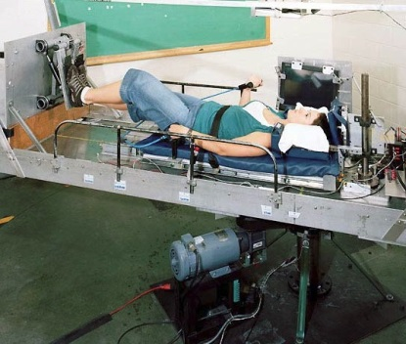
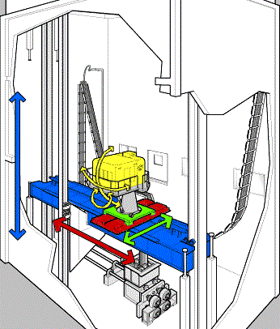
How Can We Find a Suitable Spin Rate?
1. Find effects of reversing slow spin (MIT lab?)
- Lying down lets body’s felt spin be aligned as in orbit.
- Smooth motion & co-rotating visual field also needed.
- See if reversals of ~ 0.5-2 rpm spin affect many people.
2. Mimic Coriolis accelerations in ground tests
- A long-stroke simulator like the Ames Vertical Motion Simulator can stroke when a test subject walks around.
- We can test how well visual spin cues aid adaptation.
3. And do Gemini-like tests on the way to ISS
- Dragon can use its spent booster as a counterweight.
- Spend days in lunar to Mars gravity, w/0.5-2 rpm spin.
- Spin test done on Gemini 11 was developed in <1 year!

Slide 20
How About Other Gravity Levels & Tests?
0.06 gee is the next ~1/e step: Earth - Mars - Moon - 0.06
1. This level is directly relevant only to Pluto’s gravity, but
its “next 1/e step” makes it useful for basic bio research.
2. It is easy to add (just another copy of same cabin design).
3. 0.06 gee may be about the lowest level for intuitive action:
- Sitting, using a desk, eating, hygiene, even rolling over in a bed.
- Such levels may be popular w/tourists & crew (unique sports?).
Faster spins with the same facility allow other useful tests
1.6X spin gives Earth, plus Mars & Moon at a 2nd spin rate.
1.25X spin gives 3 “half step” levels: ~ 0.6, 0.26, & 0.1 gee.
Do faster-spin tests before full outfitting, to limit loads.
Cycling crew between ends & CM tests “part-time gravity”
This tests the viability of “part-time spin” as a countermeasure.
It can also mimic EVAs to an asteroid near a spinning vehicle.
Mars
0.06g
CM
Moon

Slide 21
What Else Can We Learn from Partial Gravity Bio?
Settlement technologies
1. Viability requires food production + aggressive recycling.
2. We should start by recycling far more of what ISS discards!
3. And crops will be just a part of more complex ecosystems.
4. We don’t know how partial gravity affects crops & ecosystems!
Terraforming
5. Bio-based terraforming seems more likely than abiotic options.
6. Our most accessible options (Moon & Mars) have low gravity.
A better understanding of life on earth
7. Looking at old things in new ways usually reveals new things.
8. What can we learn about man’s ~100 most important crops?
9. And what part of what we think we know is actually wrong?

Slide 22
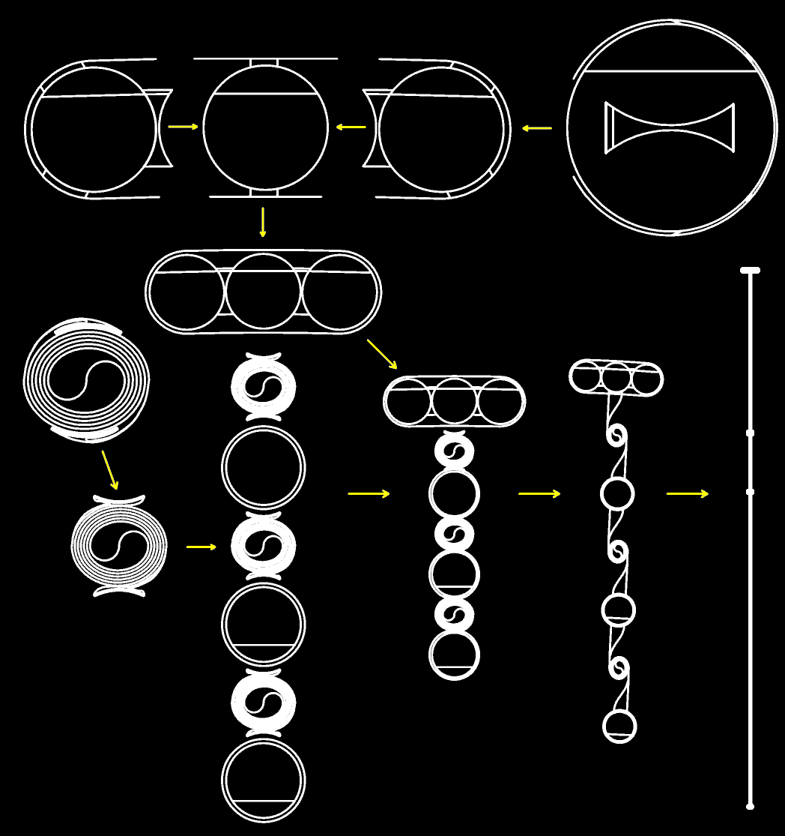
Facility Growth from 1 to 3 to 6 Cabins
1 cabin (Moon or Mars)
- Spent stage is counterweight
- “Indoor lifestyle” spin rate tests
- Might also test trapeze capture
3 cabins (Moon or Mars)
- Release counterweight & tether
- Attach 2 new cabins to old one
- Spin up w/new counterweight
6 cabins (Moon and Mars)
- Launch 3 new cabins + tunnels
- Discard old counterweight
- Join 6 cabins w/tunnels
- Spin up w/thrusters at Mars end
- Deploy tunnels one at a time, using slow spin, then inflation.
Moon
Moon
CM
0.06
Mars
Mars

Slide 23
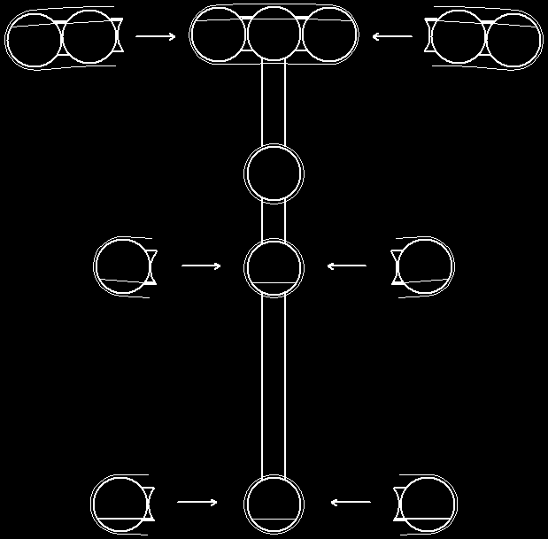
Facility Expansion from 6 to 14 Cabins
Moon
Expansion sequence:
1. Launch 8 new cabins
2. Join the “lunar pairs”
3. Despin (or slow down?)
4. Capture & attach cabins
5. Spin facility up again
6. Adjust ballast, to balance
7. Outfit new cabins later
(This assumes the tunnels were designed for 14-cabin loads.)
CM
0.06g
Mars

Slide 24

Spinning Facilities as LEO Transport Hubs
This is still my main interest in tether uses in LEO!
- Capture at apogee of MECO trajectory, and save ~100 m/s.
- Deploy enough tether to target reentry, and save ~120 m/s.
- Both raise visitor payloads, or save propellant for other use.
- Recurring benefits may make this the best “port” in LEO!
- Capture also paves way to 1.2-3.2 km/s ΔV slings (next slide).
“Trapeze” captures are unfamiliar, but may be easy
1. Null out errors during approach, not during seconds of panic!
2. Some kind of “hook and loop” interface may be all you need.
3. Remote capture allows remote safing of “unproven” visitors.
4. One can null large CG shifts with ops pairing or ballast shifts.
5. To transfer to a co-planar ISS, winch to 0.06 node & release.
6. To return, “run that movie in reverse” (with proper timing!)

Slide 25
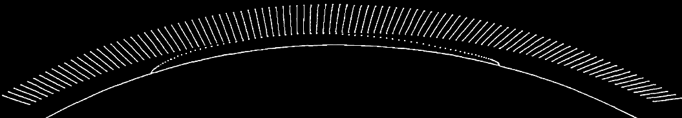
Two Operational Derivatives
Spinning exploration cruise stage
- Uses spent departure stage as ballast
- Retain stage into Mars orbit & return, with flat spin becoming conical then.
- If tether cut: lose gravity, not mission
High-deltaV spinning LEO sling
- 1.2-3.2 km/sec above and below V_{LEO}
- Similar trapeze accelerations (0.3 -1g)
- Facility must be >50X payload mass; use 2:1 spin/orbit mean rotation ratio.
- ~110 km capture altitude is needed, to allow soft sub-orbital reentries
Crew vehicle
Spent stage
Positions shown every 10 seconds,
from launch to payload handoff & reentry.
The 290 km tether is to scale with the earth.

Slide 26
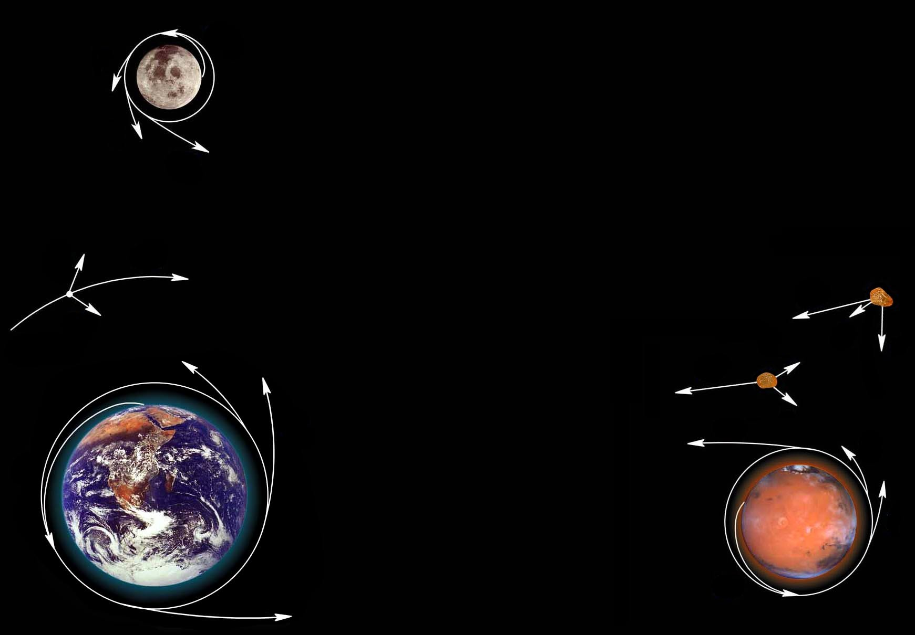
Earth-LEO-GEO-Moon-Mars DeltaVs
18
Hohmann deltaVs in units of 100 m/s,
from 400 km circular equatorial orbits.
Full deltaV is sum of start & finish #s. Orbiting slings with 1-3 km/s tip speeds can provide most or all of these deltaVs!
7
8
16
11
22
GEO
19
15
3
6
24
4
19
5
31
Bodies like earth that keep enough air to evolve life are hard to leave!
21
7
77
10
35
36

Slide 27
Bibliography
Gravity and rotation effects
M. Roach, Packing for Mars: The Curious Science of Life in the Void, W.W. Norton & Co, 2010. A fun read and good overview.
G. Clement & A. Bukley, eds, Artificial Gravity, Microcosm & Springer, 2007. Goes into detail on health effects of microgravity.
G. Nordley, Surface Gravity and Interstellar Settlement, www.gdnordley.com/_files/Gravity.pdf
J. Vernikos, The G-Connection: Harness Gravity and Reverse Aging, iUniverse, 2004.
T.H. Hall, “The Architecture of Artificial Gravity: Archetypes and Transformations of Terrestrial Design,” in Space Manufactur-ing 9, Space Studies Institute, 1993; available along with many other papers at www.artificial-gravity.com/
A. Graybiel, B. Clark, and J. Zarriello, “Observations on Human Subjects Living in a “Slow Rotation Room” for Periods of Two Days,” Archives of Neurology, 3, 55-73, 1960.
F. Guedry, R. Kennedy, C. Harris, and A. Graybiel, “Human Performance During Two Weeks in a Room Rotating at Three RPM,” NASA and US Naval School of Aviation Medicine Joint Report, 1962.
Concepts for artificial gravity facilities
D.D. Lang and R.K. Nolting, “Operations with Tethered Space Vehicles,” in proceedings of the Gemini summary conference, NASA SP-138, 1967; at http://ntrs.nasa.gov/ . See tether video at 6:40 & 10:40 at www.youtube.com/watch?v=j6EWMjgRTdg.
K. Sorensen, “A Tether-Based Variable-Gravity Research Facility Concept,” 53rd JANNAF Prop. Meeting, 2005.
B.K. Joosten, “Preliminary Assessment of Artificial Gravity Impacts to Deep-Space Vehicle Design,” JSC-63743, NASA, 2007; available at http://ntrs.nasa.gov/
J. Carroll, “Design Concepts for a Manned Artificial Gravity Research Facility,” paper IAC-10-D1.1.4, Prague, Sept-Oct 2010.
Food production and other recycling concepts
K. Kalbacher de Marquez and E. Marquez-Gonzalez. "Aquaponics: An Option for In-situ Production of Mission Consumables", 9th Symposium on Space Resource Utilization,” AIAA 2016-0720, AIAA SciTech, San Diego, 2016.
N. Katayamaa, Y. Ishikawab, M. Takaokic, M. Yamashitad, S. Nakayamae, K. Kiguchif, R. Kokg, H. Wadah, J. Mitsuhashih, Space Agriculture Task Force, “Entomophagy: a key to space agriculture,” in Adv. in Space Research, 41:5, 701-705, 2008.
H. Jones, “Would Current International Space Station (ISS) Recycling Life Support Systems Save Mass on a Mars Transit?” ICES-2017-85, available at: https://ntrs.nasa.gov/archive/nasa/casi.ntrs.nasa.gov/20170007268.pdf
J. Carroll, "Potential on Orbit Uses of Aluminum from the External Tank," AIAA/GNOS paper 83-006, Sept. 1983.
Basis of this presentation. Has far more on facility concepts. Available at www.artificial-gravity.com/.

